Slide 1
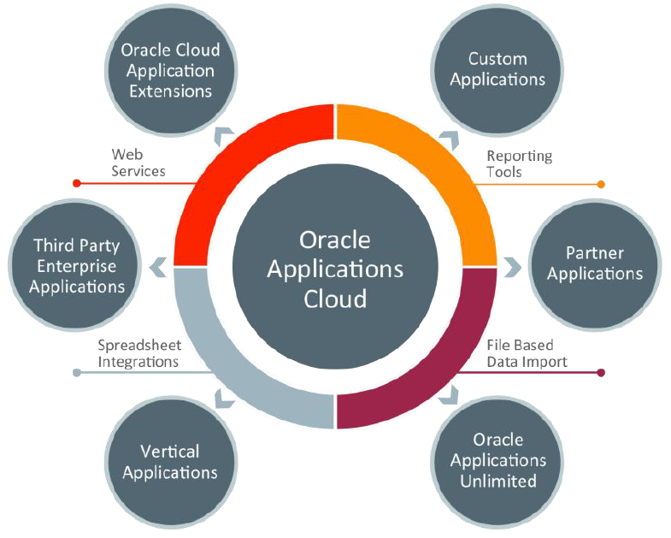

Integration Methods in Oracle Financials Cloud
Inbound Integration Methods
Web Services
File Based Data Import
Spreadsheet Data Loader
Outbound Integration Methods
Reporting Tools
Financial Extracts
Web Services

Slide 2
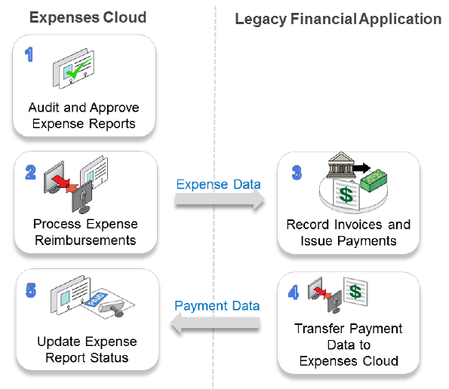
Expense Cloud - CoExistence
Create, approve and audit expense reports in Expenses Cloud
Publish expense data in XML format by using Process Expense Reimbursements background process
Import expense data in your financial application to record invoices and process payments
Transfer the payment data from your financial application to Expenses Cloud
Update expense report status as paid and associate payment reference information to expense report

